Slide 1
Young Talent Hunter
Zoilo Silang

Slide 2
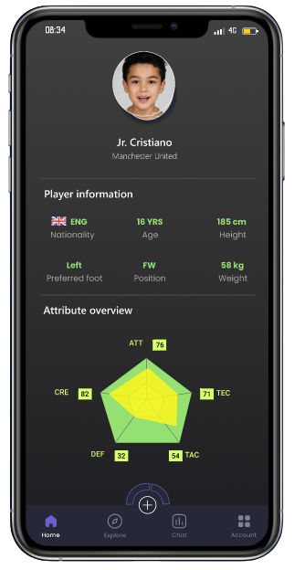

Project overview
The product:
“Young Talent Hunter” is a cross-platform mobile app
and web-based application that empowers young
talented football players to show their skills, expose
themselves to local coaches and scouts.
Preview of selected polished designs.
Project duration:
From October to November 2021

Slide 3
Project overview
The problem:
According to Goal.com (The Biggest Sport Reporting Website) more than 10 million young talents fails to make it to the Pro Football league because they don’t have the right tools to show their talent to the world.
The goal:
Build an app from the ground-up that empowers young footballer talents to show and expose their skills to coaches and scouts across the world.

Slide 4
Project overview
My role:
Lead UX designer, UX researcher, Responsive Web Design, UX Testing and Prototyping
Responsibilities:
Conducting interviews, paper and Digital wire framing, Conducting usability studies, responsive design

Slide 5
User research
Personas
Problem statements
User journey maps
Understanding
the user

Slide 6
User research: summary
Among all the design frameworks taught to us in the Google Certiﬁcation, I chose a simplistic Lean UX approach to my project. We constantly pivoted our design based on the feedback from relevant users and experts at the earliest. We performed foundational user research to understand more about the personas that is the target audience of the “Young Talent Hunter” User App

Slide 7
User research: pain points
1
2
3
4
Pain point
Pain point
Pain point
Pain point
Write one to two sentences reflecting on the pain point listed above and how it will guide designs moving forward.
Write one to two sentences reflecting on the pain point listed above and how it will guide designs moving forward.
Write one to two sentences reflecting on the pain point listed above and how it will guide designs moving forward.
Write one to two sentences reflecting on the pain point listed above and how it will guide designs moving forward.

Slide 8
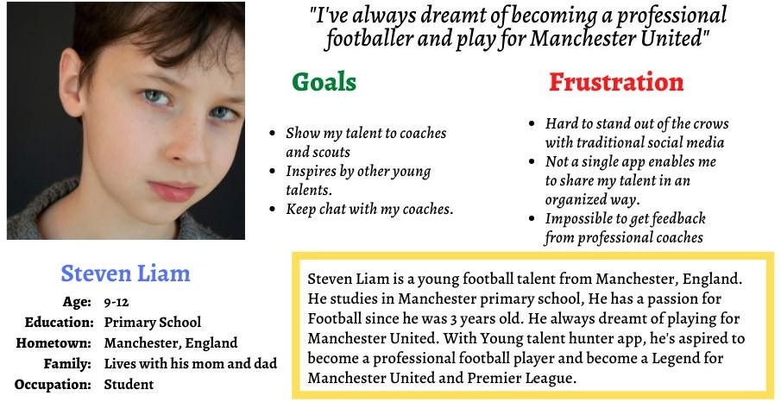
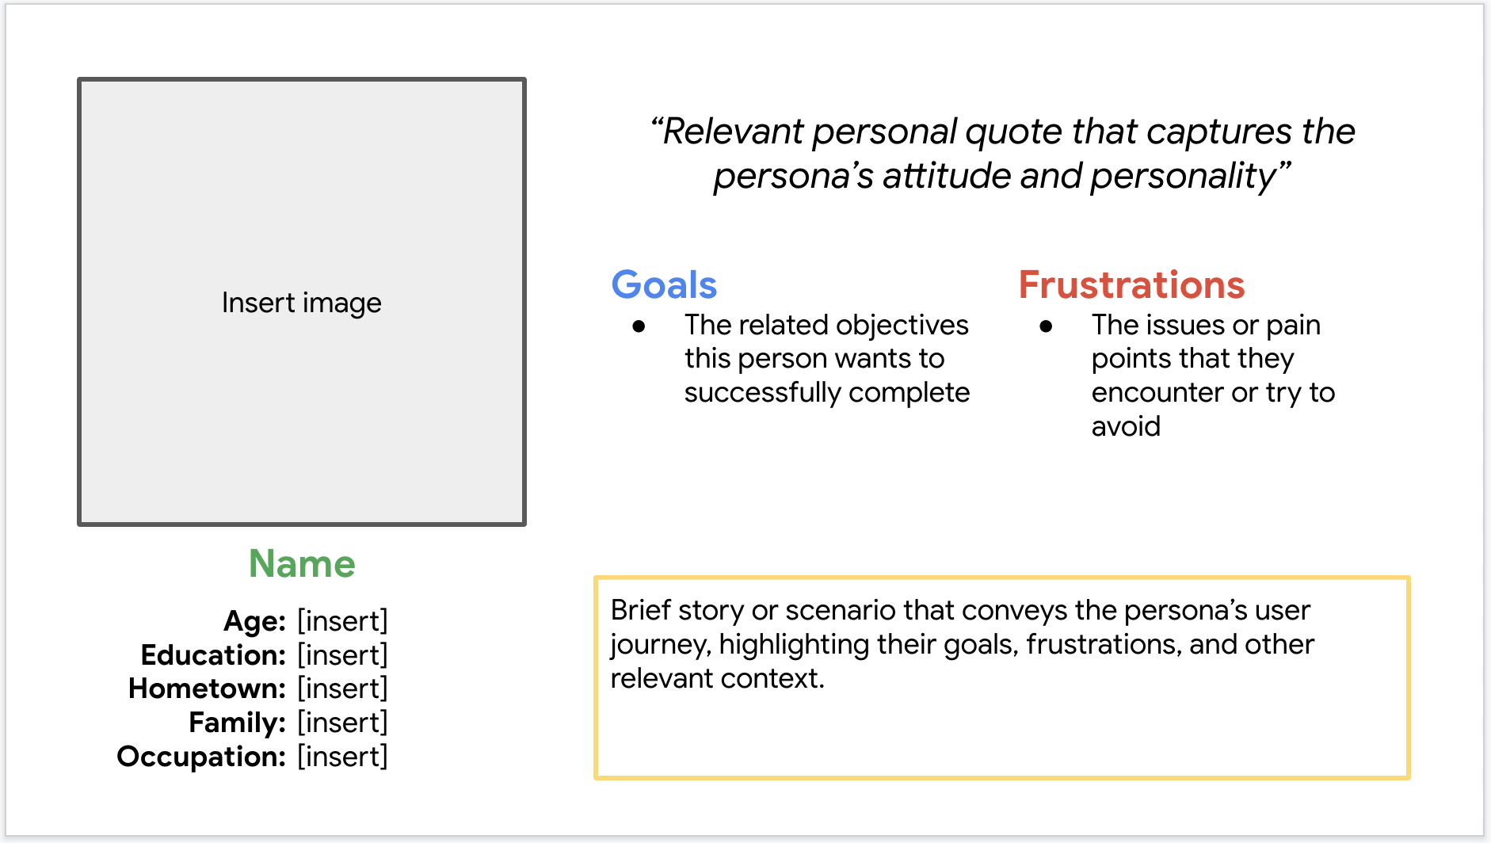
Persona 1: Steven Liam
Problem statement:
Steven Liam is a student and young Football talent who needs an App to share his talents to
the coaches and scouts because there is no platform that helps him to expose

Slide 9
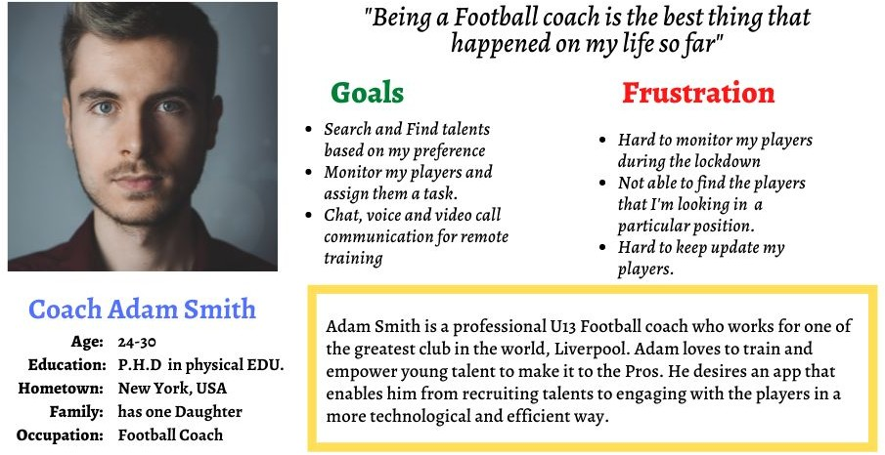
Persona 2: Adam Smith
Problem statement:
Adam Smith is a
professional football
coach who needs an
app/website that enables
him to recruit talents
across the world
because he believes in
young talent, aspire to
help them make it to Pro
team

Slide 10
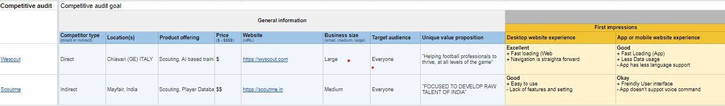
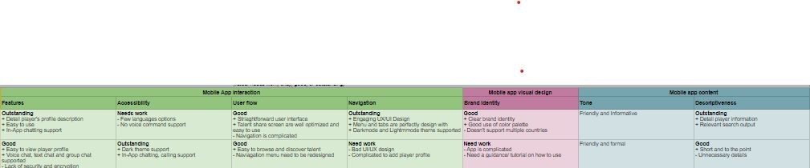
Competetive Audit
Here are the audit of us
direct and indirect
competitors that helps us to
overcome the gaps and
take full advantage of the
opportunities in the market
Image of user journey map
For competitive audit report spreadsheet. Click here

Slide 11
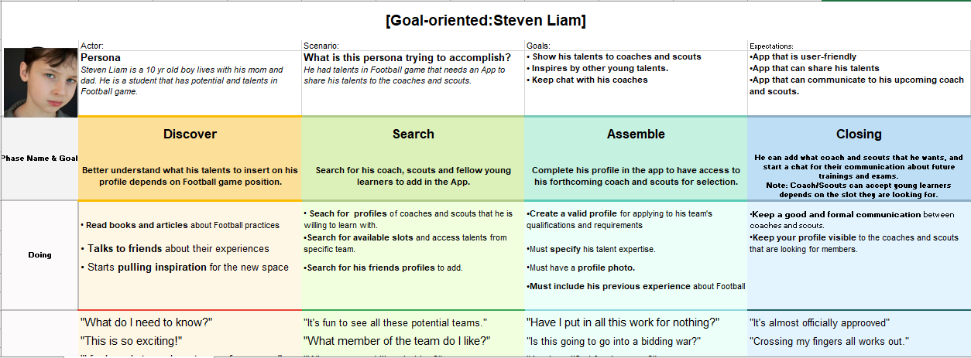
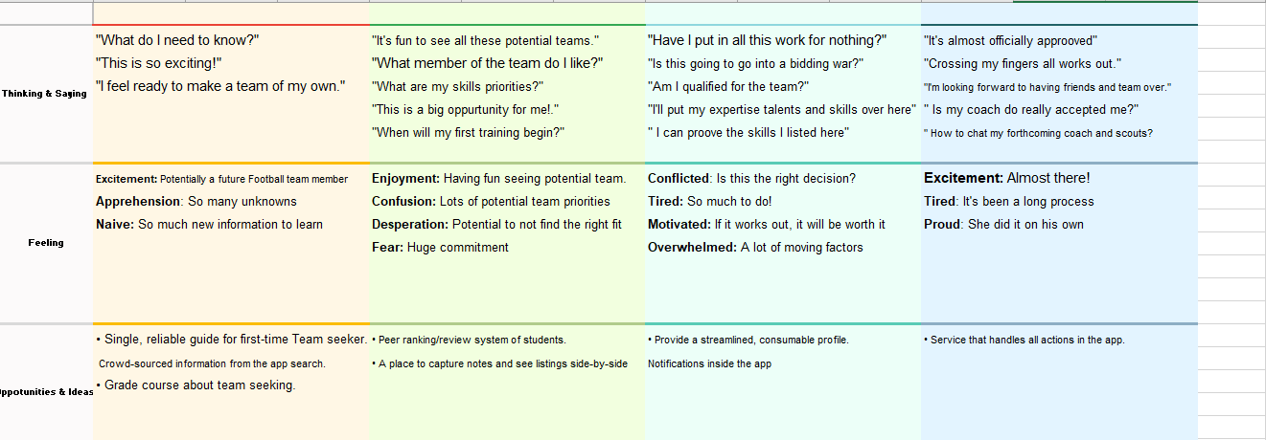
User Journey Map
In the user journey, I wanted to see the steps of a student who is willing to be part of a Football team. For the app to work well, the environment of the Young talent Hunter must be correctly set. The technical issues, Wi-Fi connection or mobile data connections must be turn on to use this app. I

Slide 12
Paper wireframes
Digital wireframes
Low-fidelity prototype
Usability studies
Starting
the design

Slide 13
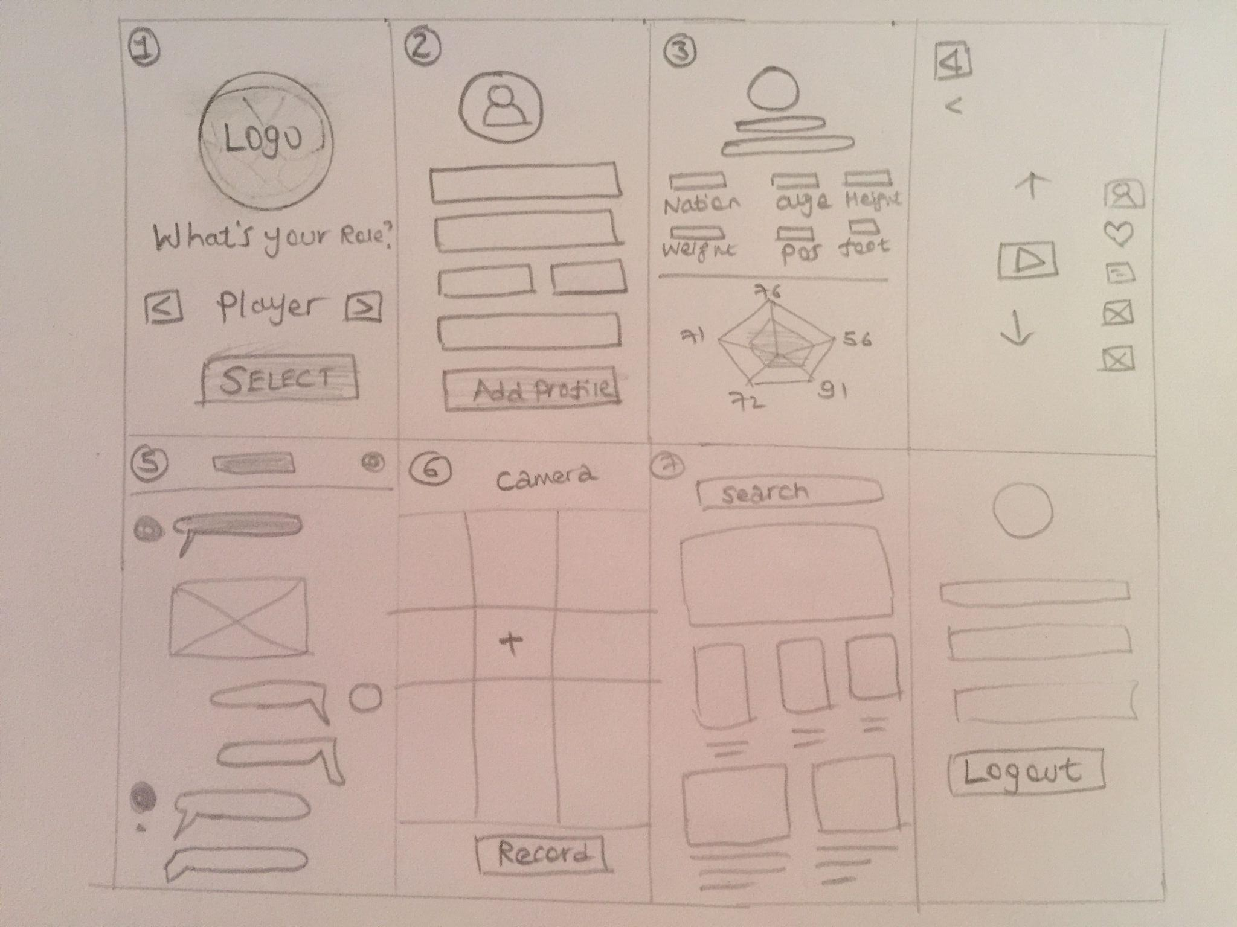
Paper Wireframe
I did the paper wireframe process based on the Lean UX approach. My intention was to help young footballer talents to show their skills, get recognized by Coaches and scouts all over the world.
Image of paper wireframes including five different versions of the same screen and one image of the new, refined version

Slide 14
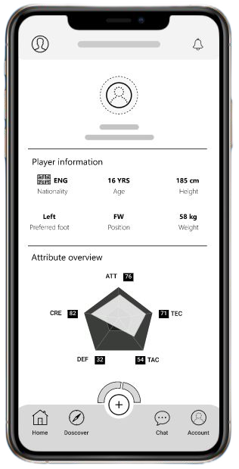
Digital wireframes
User’s account information
After ideating and paper
wire framing, I come up
with the first concept of
Digital wire framing, which
enables “Young Footballer
talents” to track their
progress that they have
given by coaches
Insert first wireframe example that demonstrates design thinking aligned with user research
Player’s detail information
Player’s development progress chart
Navigation Menu

Slide 15
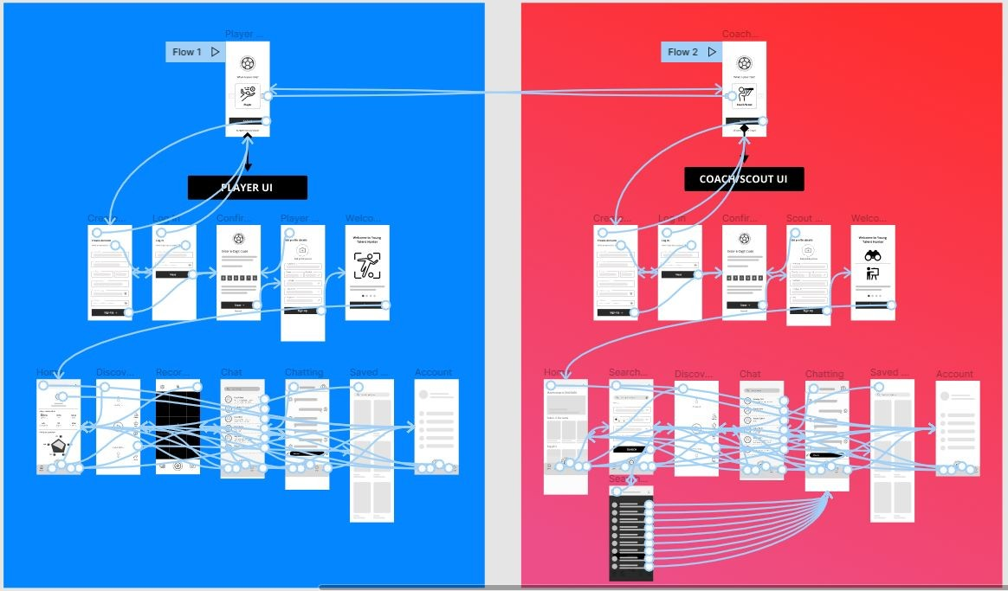
Low-fidelity prototype
Before preparing for usability study, I have implemented the low-ﬁdelity prototype in Figma that illustrate the user ﬂow from two sides of perspective (Player and Coach/Scout)
Screenshot of prototype with connections or prototype GIF

Slide 16
Usability study: parameters
Study type:
Unmoderated usability study
Location:
USA, remote
Participants:
5 participants
Length:
15-20 minutes

Slide 17

Usability study: findings
These were the main ﬁnding uncovered by the usability study
1
3
Players want a built-in chatting feature to stay in touch with their coaches and scouts
Players ﬁnd it confusing to record and upload their video into the app
Coaches/Scouts needs an easy way of searching players based on their position, play style, age and gender

Slide 18
Refining
the design
Mockups
High-fidelity prototype
Accessibility

Slide 19
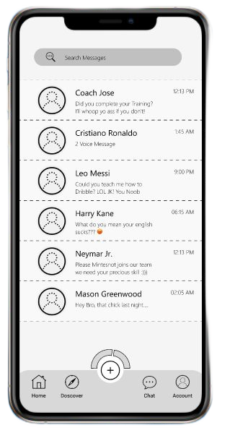
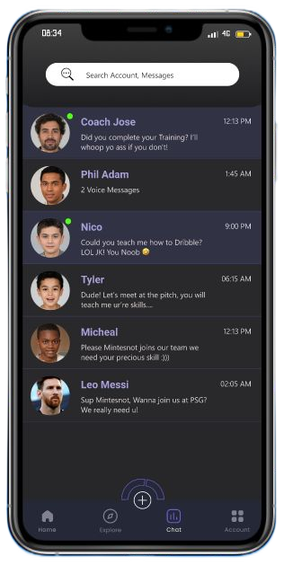
Mockups
Before usability study
After usability study
Based on the insights from usability studies, I applied a feature changes such as an indication of online users, a dark screen for people who have hard time using app with high brightness
Image of selected screen before usability study
Image of selected screen after usability study

Slide 20
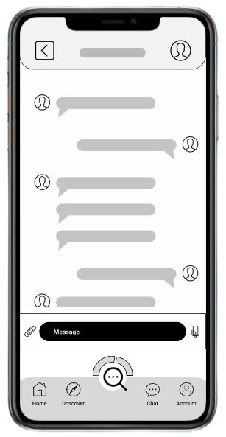
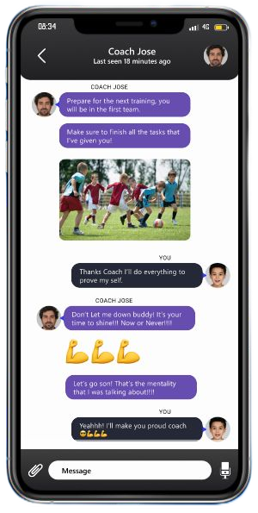
Mockups
Before usability study
After usability study
A minor change has been added based on research insights, Now the chatting screen has more space and freedom to chat with coaches and scouts.
Navigation menu removed from chatting
Image of selected screen before usability study
Image of selected screen after usability study

Slide 21
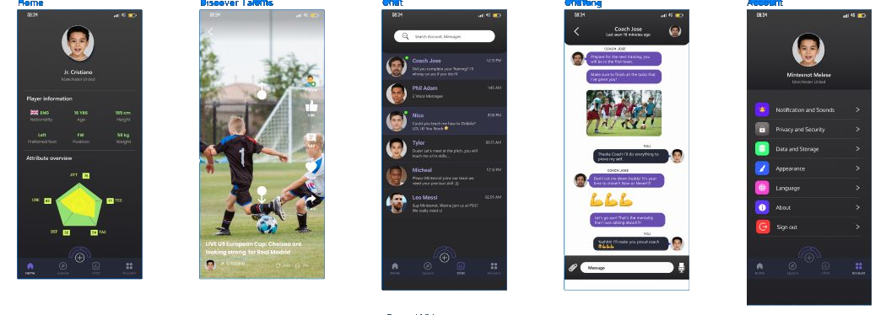
Mockups

Slide 22
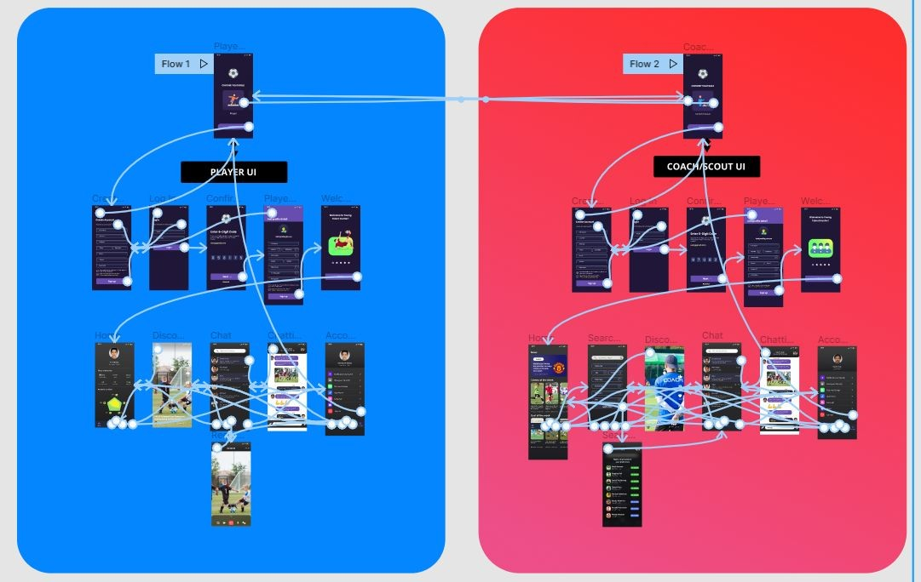
High-fidelity prototype
The High-Fidelity prototype has two main part, Player and Coach/Scout. After the research insight were created, changes have made from the usability study
Screenshot of prototype with connections or prototype GIF

Slide 23
Accessibility considerations
1
2
3
Dark theme added, an easy to eye interface, Based on Google’s
material design guideline
Home screen has all the important information
without leaving the screen
Multiple Language

Slide 24
Responsive Design
Information Architecture
Responsive Design

Slide 25
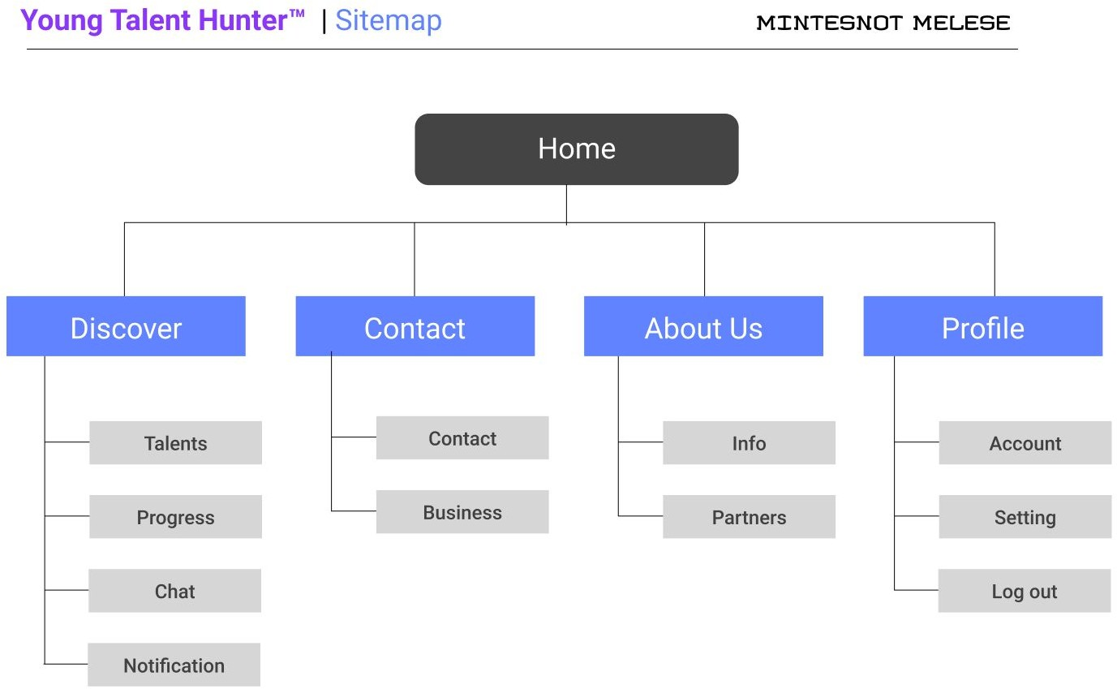
SITE MAP
After the app design was
completed, I started to
design the sitemap for
responsive website, The
sitemap structure is well
optimized to work with
different screen size and
resolution (Across all
devices and platforms)

Slide 26
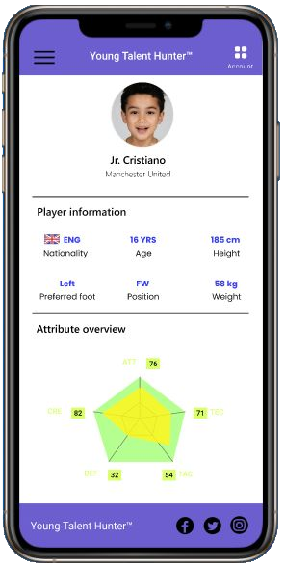
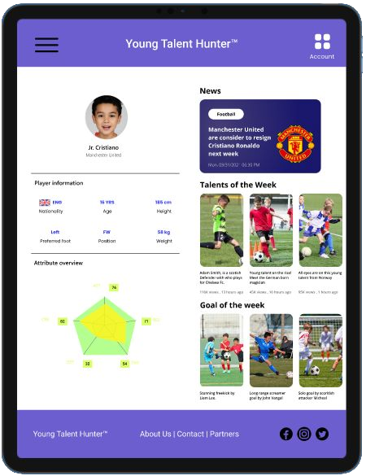
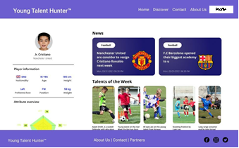
Mobile View
Responsive designs
Tablet (iPad Pro)
The screen vibration consists of major resolutions, such as mobile, tablet and desktop website. Each interface and design are well optimized and intended to take advantage of the native resolution of device
Desktop View

Slide 27
Going forward
Takeaways
Next steps

Slide 28
Takeaways
Impact:
Young Talent Hunte, is a highly successful project that empowers young footballer talents to take advantage of the tool that we have created and show to the world what they are made of. We will enable millions of talents to get a scouted and help them play in Pro and competitive league
What I learned:
Throughout the project I have learned Foundations of User Experience (UX) Design, Start the UX Design Process: Empathize, Deﬁne, and Ideate, Build Wireframes and
Low-Fidelity Prototypes, Conduct UX Research and Test Early Concepts, Create High-Fidelity Designs and Prototypes in Figma, Responsive Web Design in Adobe

Slide 29
Next steps
1
2
3
Conduct a post research
on how the app
performed and perceived
by users
Create an online
documentation and
how-to tutorial videos to
help users easily
understand how the
App/Website works
Update prototype based
on findings and pass over
to the engineer

Slide 30
Insert a few sentences summarizing the next steps you would take with this project and why. Feel free to organize next steps in a bullet point list.
Let’s connect!
Thanks for reviewing my Case Study “Young Talent Hunter“ App/Website project, that I have created for Google UX certificate program. For Business Inquiry, email at silangzoilo@gmail.com

Slide 31
Thank you!

